Slide 1
SRI BALAJI CHOCKALINGAM ENGINEERING COLLEGE, ARNI.
DEPARTMENT OF INFORMATION TECHNOLOGY
IMPLEMENTATION OF A PREDICTIVE ANALYTICS SOFTWARE TOOL FOR LOAN EVALUATION BASED ON COMPREHENSIVE CUSTOMER DEMOGRAPHICS
AND FINANCIAL BEHAVIOR
Supervised by
M.E.,
Assistance Professor
Dept of Information Technology
Presented by
VIGNESH .A - [512721205043]
MANIVANNAN.C - [512721205301]

Slide 2
Abstract
Loan approval prediction is a practical application of machine learning that helps in evaluating the eligibility of loan applicants based on their financial history and profile. In our daily lives, applying for a loan involves several checks and can be time-consuming. Many applicants face uncertainty regarding whether their application will be approved or rejected. The proposed system is designed to simplify this process using an intelligent prediction model. This system uses a Decision Tree classifier, a machine learning algorithm, to analyze various financial factors like income, credit score, loan amount, and asset value. The model is trained using historical loan data and then used to predict the likelihood of loan approval for new users. This web-based system allows users to register, log in, and receive real-time predictions about their loan status, making the process faster, more accessible, and transparent.

Slide 3
Introduction
Loan approval prediction helps banks make faster and more accurate decisions about loan applications. Traditional methods are slow and can be biased. This project uses a Decision Tree machine learning model to predict loan eligibility based on user financial data. The system includes steps like data preprocessing, model training, and prediction. A user-friendly web interface built with Flask allows users to input their details and get instant results. This approach makes the loan process quicker, fairer, and more efficient.

Slide 4
Existing System
Manual Processing: Loan applications are reviewed manually, which is time-consuming and prone to human error or bias.
Rule-Based Systems: Banks often use fixed rules (like minimum income or credit score cutoffs) to approve or reject applications.
No Instant Feedback: Applicants usually wait days or weeks to know their loan status.
Lack of Personalization: Current systems do not analyze individual financial profiles deeply; all applicants are evaluated by the same rigid criteria.
Limited Automation: Most traditional systems do not use machine learning to automate or improve decision-making accuracy.

Slide 5
Demerits of Existing System
Data Overload: The growing volume of crime data makes it difficult to store and process efficiently.
Manual Effort: Collecting and analyzing data manually is time-consuming and labor-intensive.
Delayed Insights: Manual systems cannot provide real-time updates or early warnings for new crime trends.
Low Accuracy: Difficulty in accurately identifying crime hot spots due to limited analytical tools.
No Visualization Tools: Absence of interactive crime hot spot map visualizers limits understanding and public awareness.

Slide 6
Proposed System
This proposed system combines the interpretability of Explainable Decision Tree (xDT) for transparent loan approval predictions with the integration of a user-friendly web interface. It aims to empower loan applicants and financial institutions by providing clear insights into loan eligibility while offering a smooth and accessible user experience.
Explainable Predictions: Transparency in decision-making to understand key factors influencing loan approval or rejection.
Real-time Evaluation: Instant prediction and feedback based on applicant data to provide quick loan eligibility results.
User-Friendly Interface: Intuitive platform for users to input data, view predictions, and understand the reasoning behind loan decisions.

Slide 7
Merits of Proposed System
Accurate Risk Assessment Predicts loan default probability using historical data, reducing the chances of financial loss.
Faster Loan Processing Automates eligibility checks, significantly reducing processing time for both applicants and banks.
Improved Decision-Making Helps financial institutions make informed, data-driven decisions on loan approvals.
User-Friendly Interface Simple and intuitive web interface allows easy interaction for both users and loan officers.
Scalable and Adaptable Can handle a large number of applications and be updated easily with new data or criteria.
Cost-Efficient Reduces the need for manual review, cutting down labor costs and increasing operational efficiency.
Real-Time Predictions Offers quick predictions, helping users get instant feedback on loan eligibility.
Secure and Confidential Ensures customer data is processed securely and maintains privacy compliance.

Slide 8
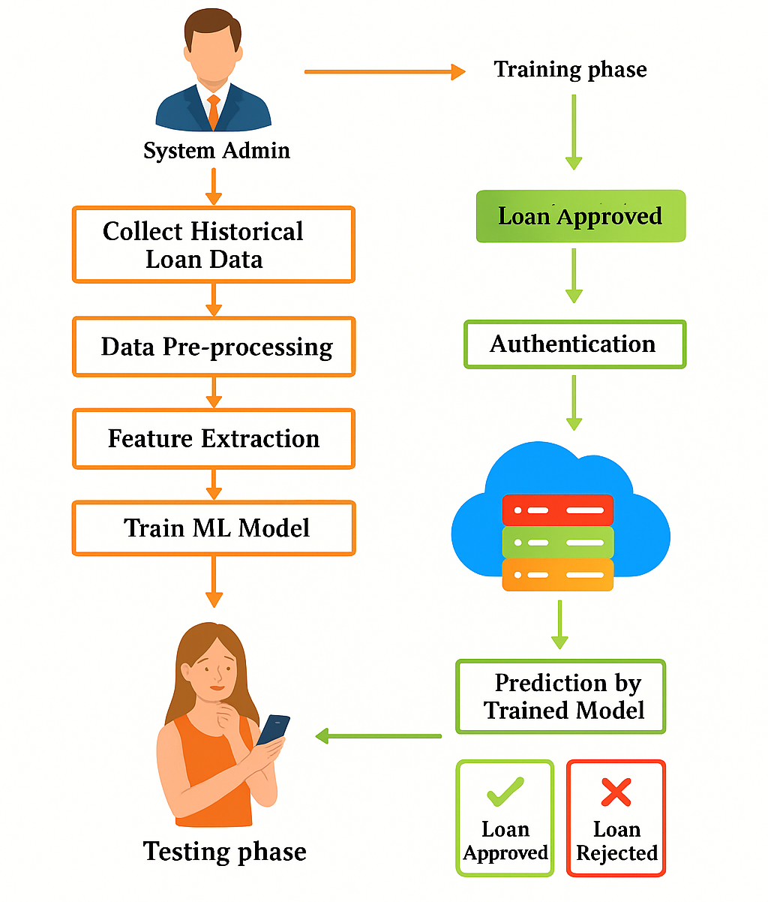
Centralized Architecture Diagram

Slide 9
System Specifications
HARDWARE REQUIREMENTS:
System : Pentium IV 2.4 GHz
Hard Disk : 40 GB
Floppy Drive : 1.44 Mb
Monitor : 15 VGA Colour
Mouse : Logitech
Ram : 512 Mb

Slide 10
SOFTWARE REQUIREMENTS:
Language : Python
Frontend : HTML And CSS
Backend : Machine Learning
Server : Django
Operating system : Windows 10
IDE : Google Colab

Slide 11
List Of Modules
User Authentication Module
Prediction Module
Flask Web Interface Module
Data Handling Module
Database Module

Slide 12
1. User Authentication Module:
• Allows users to sign up and log in securely using a usernaame and password.
2. Prediction Module:
• Uses a machine learning model to predict if a loan will be approved based on user data.
3.Flask Web Interface Module:
• Provides a user-friendly website for input and displays the prediction result.

Slide 13
4.Data Handling Module:
• Collects, cleans, and prepares the input data for accurate prediction.
5.Database Module:
• Stores user details and data securely using a database like SQLite.

Slide 14
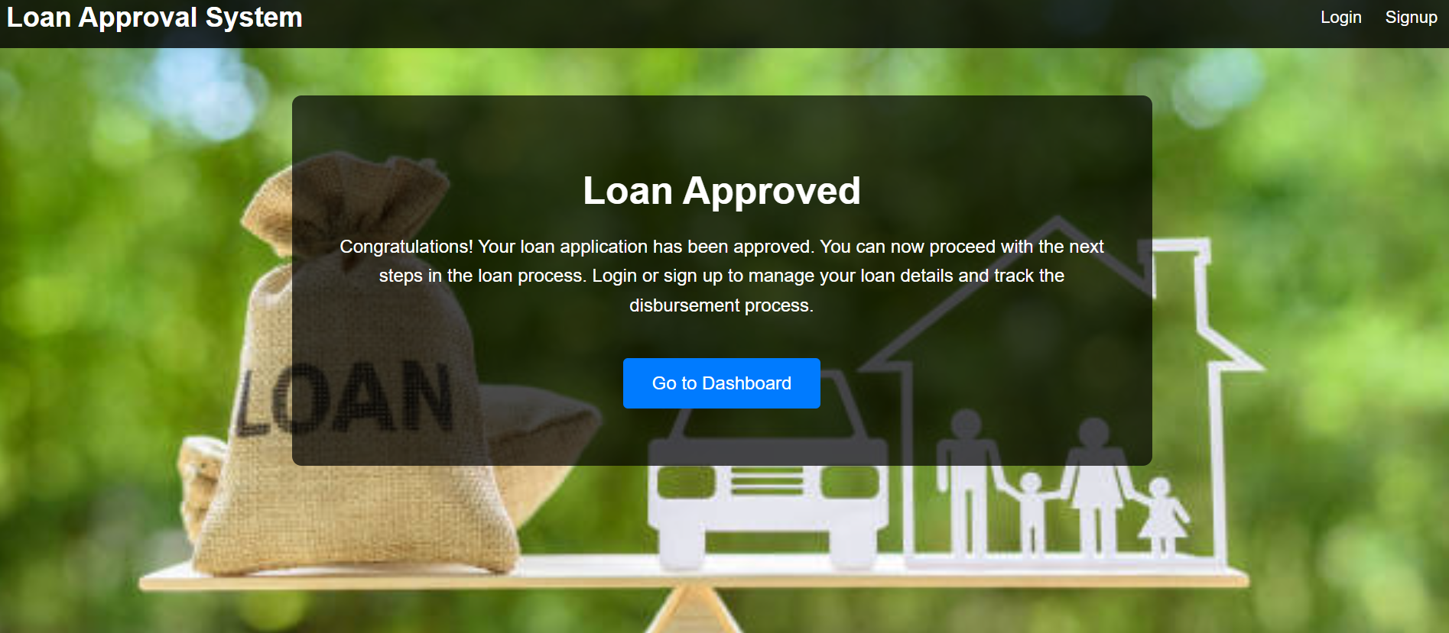
SCREEN SHOTS

Slide 15
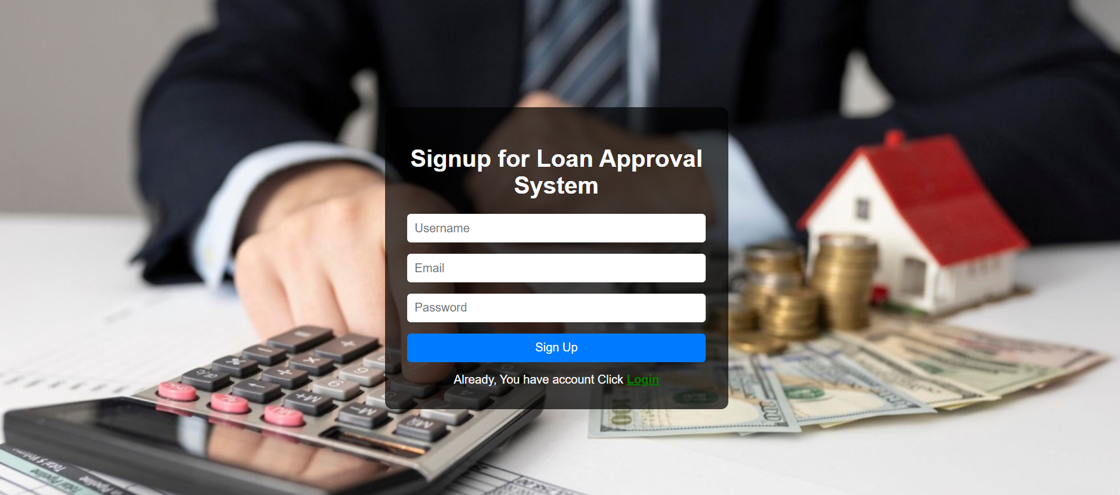

Slide 16
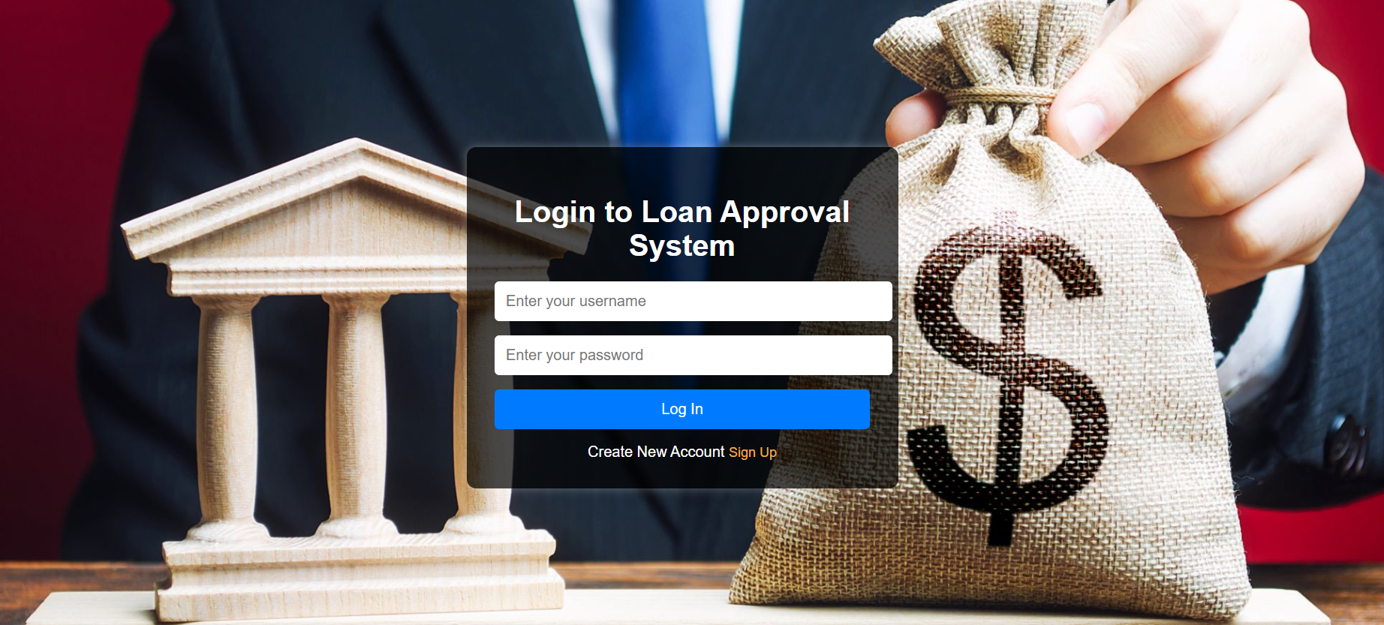

Slide 17
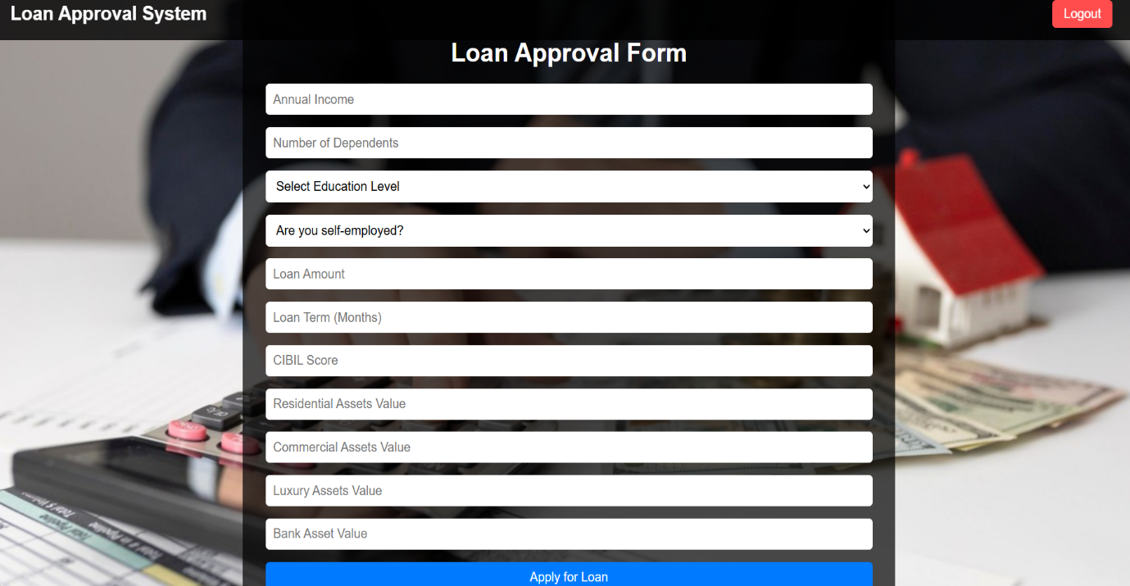

Slide 18


Slide 19
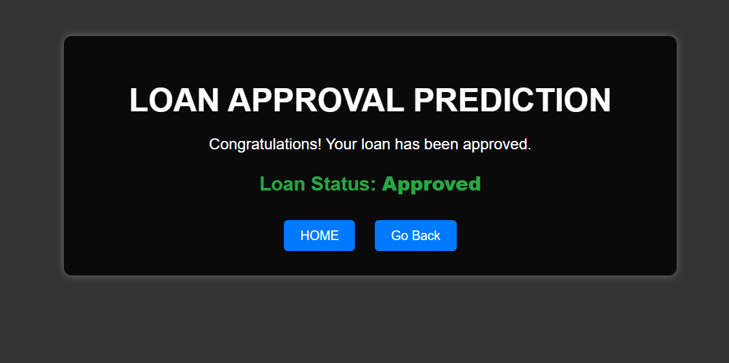

Slide 20
Conclusion
✅ The proposed web-based Loan Prediction System uses an Explainable Decision Tree (xDT) algorithm for transparent and understandable predictions.
📊 It helps predict loan approval status based on user input such as income, credit history, employment, and other relevant features.
🔍 The explainable model ensures that users can clearly understand why a loan is approved or rejected.
⚡ The system provides real-time prediction and feedback, enhancing user experience and reducing wait times.
🖥️ A user-friendly interface enables applicants to easily input their data and interact with the system without technical knowledge.

Slide 21
Future Enhancement
Model Optimization and Generalization:
Apply pruning techniques to Decision Tree to reduce overfitting.
Bias Reduction and Explainability:
Use Explainable AI (XAI) to increase decision transparency.
Detect and mitigate bias to avoid discrimination.
Real-Time Data Integration:
Integrate real-time financial data (credit bureaus, bank transactions, tax records).
Implement Federated Learning to train across institutions without sharing data.
Use differential privacy and homomorphic encryption for data security.
Optimize Flask-based API for better performance and integration.
Adaptive Learning and Feedback:
Implement self-learning systems that update with new loan data automatically.

Slide 22
References
[1] A. Gupta, V. Pant, S. Kumar, and P. K. Bansal, "Bank Loan Prediction System using Machine Learning," 2020 9th International Conference on System Modeling and Advancement in Research Trends (SMART), 2020, pp. 423–426.
[2] V. Singh, A. Yadav, and R. Awasthi, "Prediction of Modernized Loan Approval System Based on Machine Learning Approach," 2021 International Conference on Intelligent Technologies (CONIT), 2021, pp. 1–4.
[3] P. S. Saini, A. Bhatnagar, and L. Rani, "Loan Approval Prediction using Machine Learning: A Comparative Analysis of Classification Algorithms," 2023 3rd International Conference on Advance Computing and Innovative Technologies in Engineering (ICACITE), 2023, pp. 1821–1826.
[4] N. Uddin et al., "An Efficient Loan Approval Status Prediction Using Machine Learning," 2022 2nd International Conference on Artificial Intelligence and Smart Energy (ICAIS), 2022, pp. 349–353.
[5] U. E. Orji et al., "Machine Learning Models for Predicting Bank Loan Eligibility," 2022 IEEE Nigeria 4th International Conference on Disruptive Technologies for Sustainable Development (NIGERCON), 2022, pp. 1–5.

Slide 23
THANK YOU

